Slide 1

Rockbuster Stealth LLC
Sara Afsarigolshan,Data Analyst
July 1 ,2023

Slide 2

Introduction
Rockbuster Stealth,a movie rental company,aims to shift its sales from physical stores to expand its online video rental services in order to better compete with prominent rivals.
The company plans to analyze its current movie licenses to identify the necessary improvements and services required to establish a competitive presence in the market.

Slide 3

Key Questions and Objectives
What was the average rental duration for all videos?
Which movies contributed the most/least to revenue gain?
Where are customers with a high lifetime value based?
Which countries are Rockbuster customers based in?
Do sales figures vary between geographic regions?

Slide 4
What was the average rental duration for all videos?
Rental Statistics

Slide 5
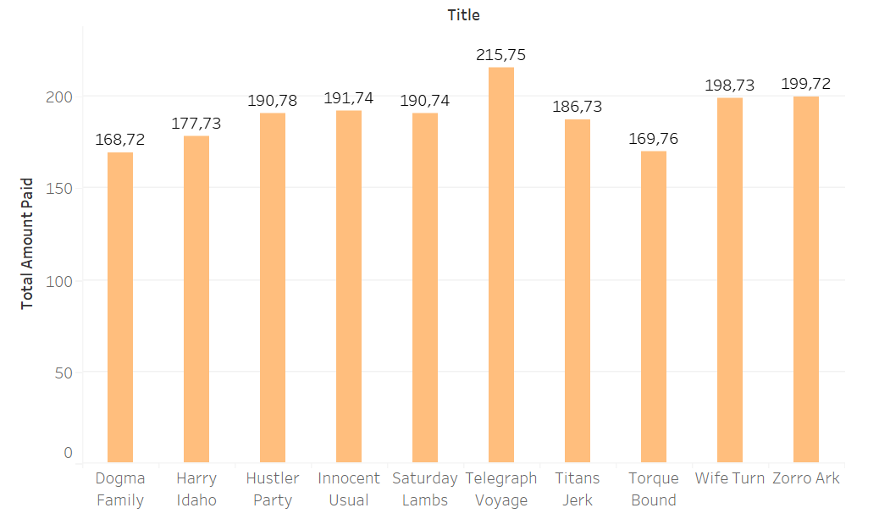
Which movies contributed the most/least to revenue gain?
Highest Grossing Movies to be included in streaming services to continue to capture profits:
Telegraph Voyage
Zorro Ark
Wife Turn
Innocent Usual
Hustler Party
Best/Worst Movie Contributors

Slide 6
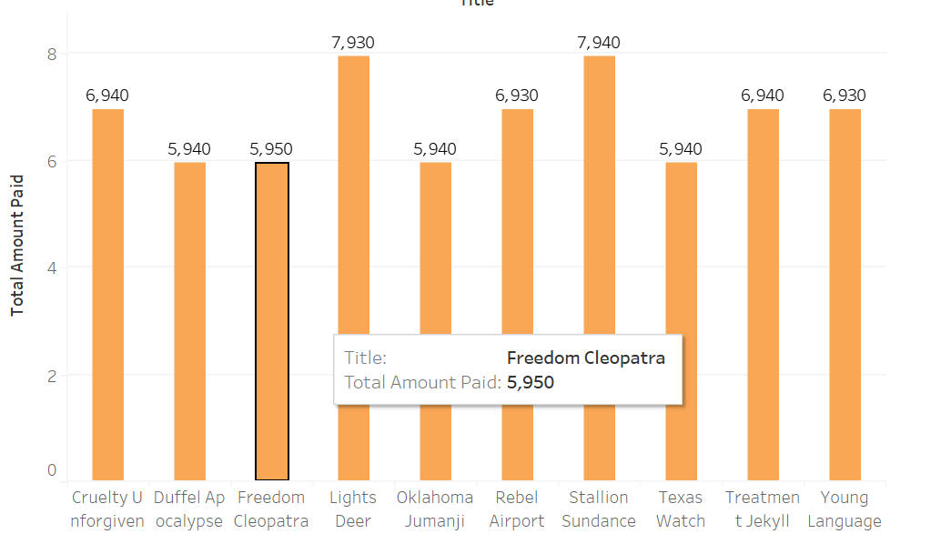
Which movies contributed the most/least to revenue gain?
Least Grossing Movies to be considered dropping from streaming services to minimize cutting into profits:
Duffel Apocalypse
Oklahoma Jumanji
Texas Watch
Freedom Cleopatra
Young Language
Rebel Airport
Best/Worst Movie Contributors

Slide 7
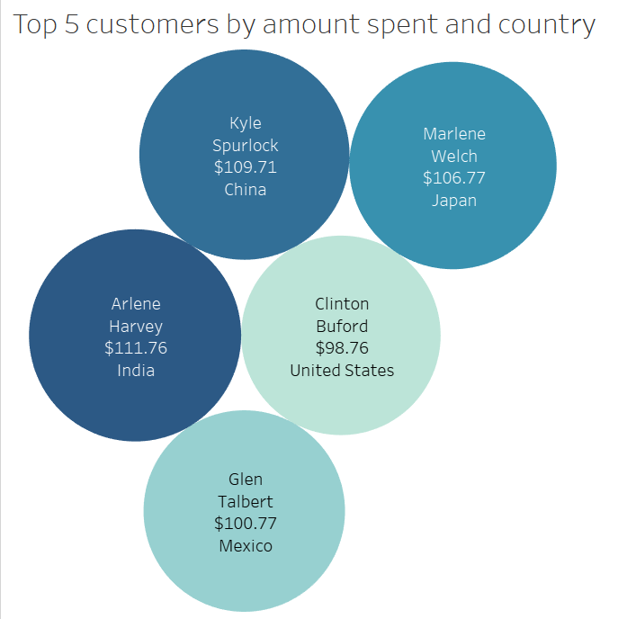
Where are customers with a high lifetime value based?
-Top five lifetime customers are spread around the world.
-Spend is separated by only around $13.
This information will allow the customer team to develop a loyalty rewards program.
Top Five Customers

Slide 8
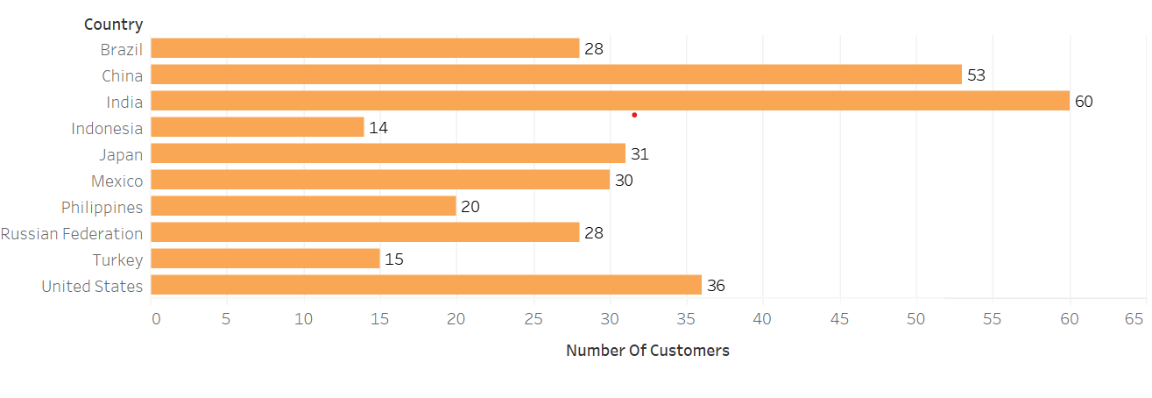
Which countries are Rockbuster customers based in?
Identifying the top 10 countries by the number of customers will allow us to focus on building a better brand image in these markets.
Top 10 Countries

Slide 9
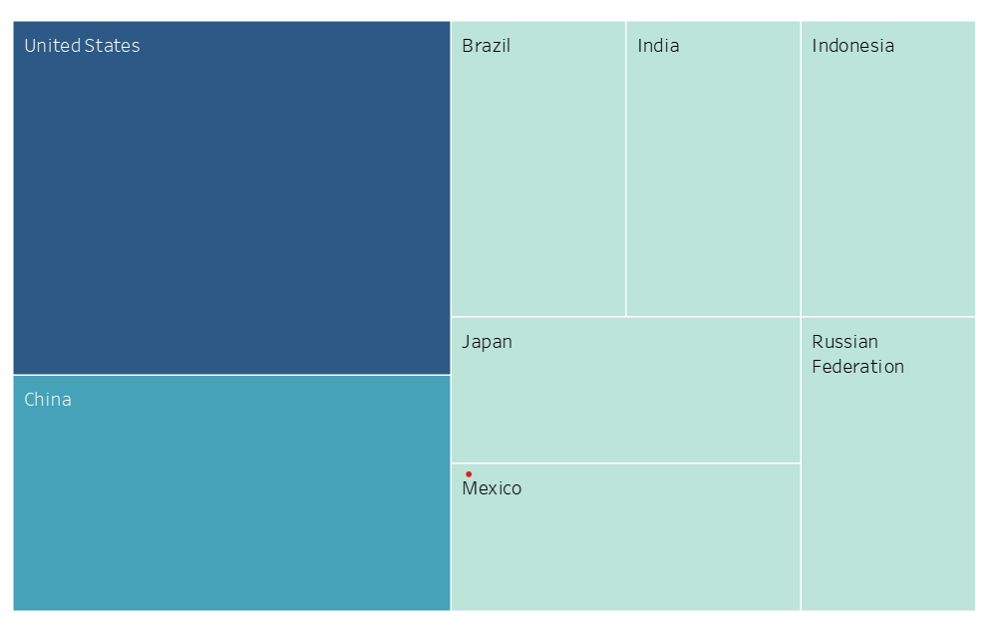
Which countries are Rockbuster customers based in?
Top 10 Cities

Slide 10
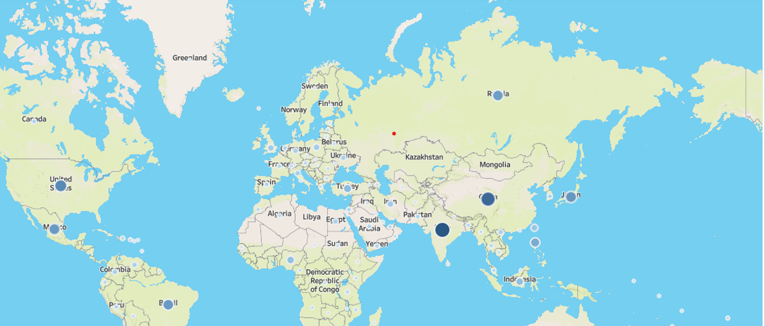
Where Our customer are

Slide 11
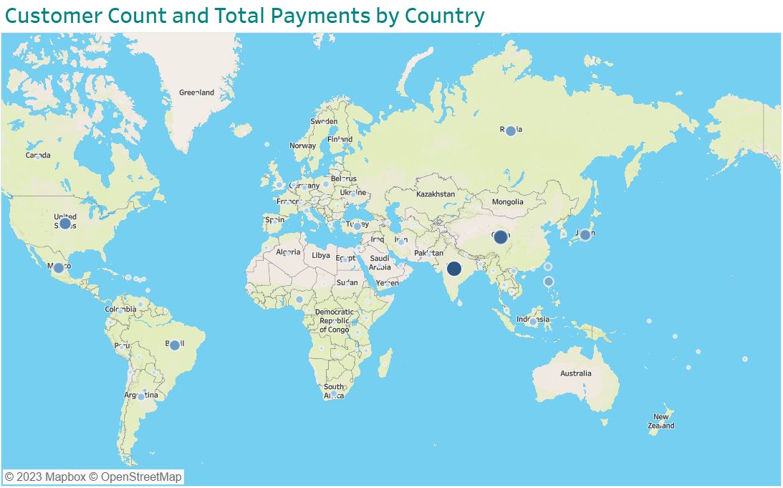
Do sales figures vary between geographic regions?
Where Our customer are

Slide 12
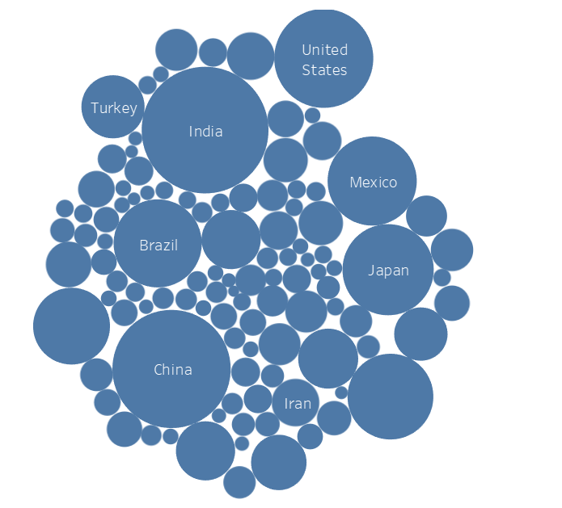
Top Countries by total amount spent:
India
China
United States
Japan
Mexico
Brazil
Russian Federation
These are consistent with the number of customers per country.
Utilization by Country

Slide 13

Summery
Rockbuster Stealth LLC has the opportunity to transition into streaming services for online video rentals. By analyzing our existing rental demographics, we can:
Develop a customer loyalty program
Offer movies that are most relevant and popular with our customers
Focus marketing and brand into the highest utilizing countries

Slide 14

Thanks
Sara Afsarigolshan
Tamara.Golshan@gmail.com

